Slide 1
ISLA
PORTUGAL
Prof. Isabel Vilaça

Slide 2
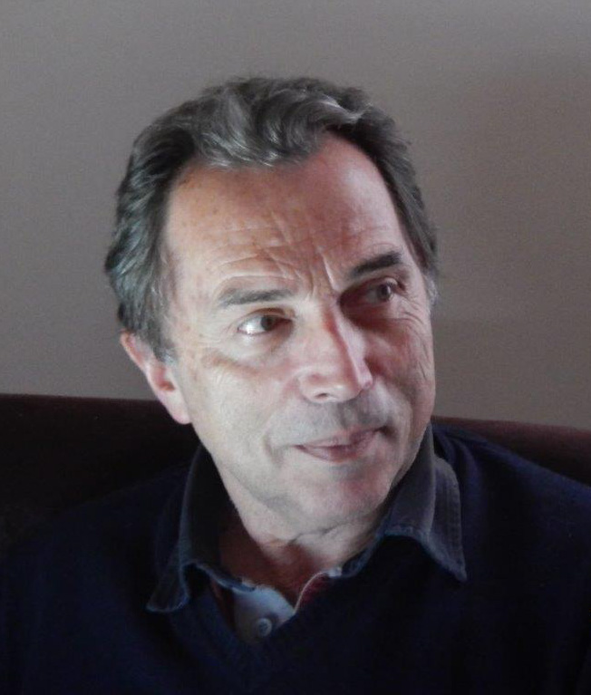
Greetings from Diretor

Slide 3
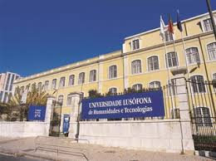
About the Institution
ISLA is a private, polytechnic institution.
It is one of the schools belonging to the Grupo Lusófona, founded in 1998.
The group has schools in the more important cities in Portugal (Lisbon, Porto, Leiria, Caldas da Rainha…..) and in countries where the Official Language is Portuguese (Cape Verde, Angola, Mozambique…)
The group comprises approximately 10,000 students

Slide 4
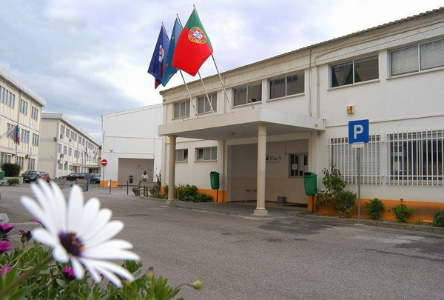
ISLA - LEIRIA
Having been a university for many years, in 2015 it became a Polytechnic Institute with the following objectives:
Courses in human, cultural, scientific and technical skills;
Undertaking fundamental and applied research;
Actively participating in the national education system;
Providing services to the community;
Participating in defending the environment;
Contributing towards the development of Portugal.

Slide 5
Current situation
Courses ministered:
Undergraduate Degrees
Professional Higher Education Technical Courses
Master’s Degrees
Non-degrees (MBA and Post Graduations)

Slide 6
Current situation
Undergraduate degrees:
Management
Management of Human Resources
Commercial Management

Slide 7
Current situation
Professional Higher Education Technical Courses
Tourism
Administrative Management of Human Resources
Management IT

Slide 8
Current situation
Master’s Degrees
Master’s in Human Resources Management

Slide 9
Current situation
Non-degree courses
MBA in Management
Advanced Post Graduation in Management of HR
MBA in Logistics
Post-Graduation in Health Management and Administration

Slide 10
Why is ISLA focused on management?
Leiria is located in a very industrialised area.
Sectors most represented: moulds, plastics, ceramics and glass industries.
ISLA seeks to respond to the needs of these industries.
It is a modern, technological and sophisticated business network, and one that is increasingly more focused on internationalisation.

Slide 11
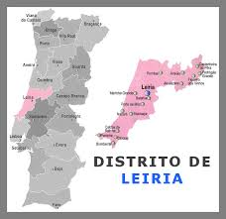
Region of Leiria
Located in the centre of Portugal.
Between the two better known cities at the moment: Lisbon and Porto (benchmark tourist destinations on a worldwide level)

Slide 12
Region of Leiria
Inhabitants - 286,309
Highly industrial.
High volume of exports (5th district with the highest balance of trade in Portugal).
The region exports mostly to Europe (Spain, France and Germany are the main export destinations).
The extra-Community exports have increased substantially (with the USA at the top of the list, but also to Brazil and to many African countries).

Slide 13
Beyond the industry…..
The region of Leiria is surrounded by a heterogenous landscape, which includes the sea, the mountains, and the sun, as well as extraordinary historical heritage, including two Unesco World Heritage monuments:

Slide 14
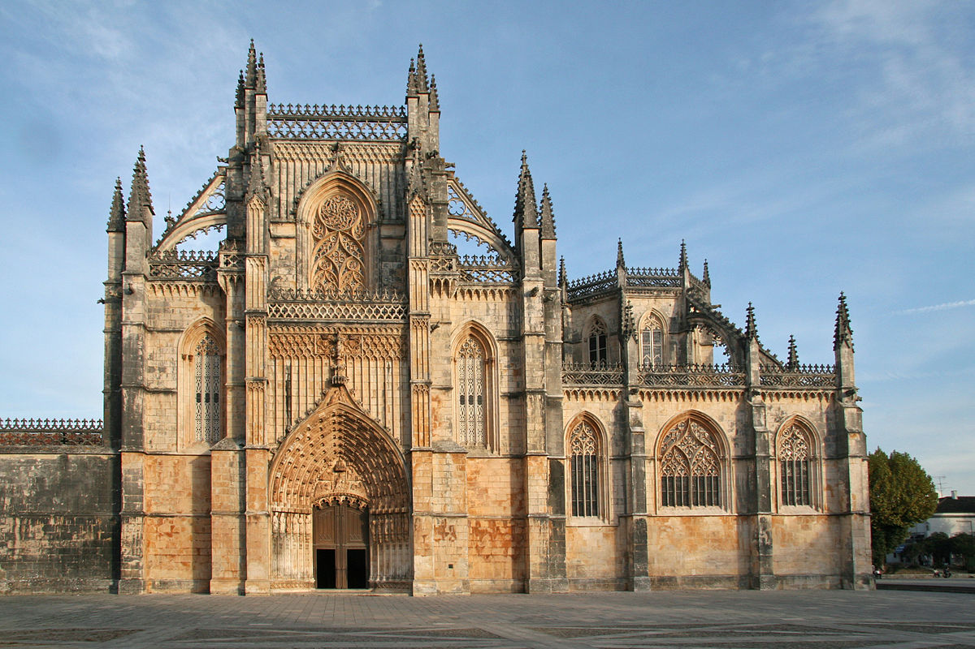
The Monastery of Batalha

Slide 15
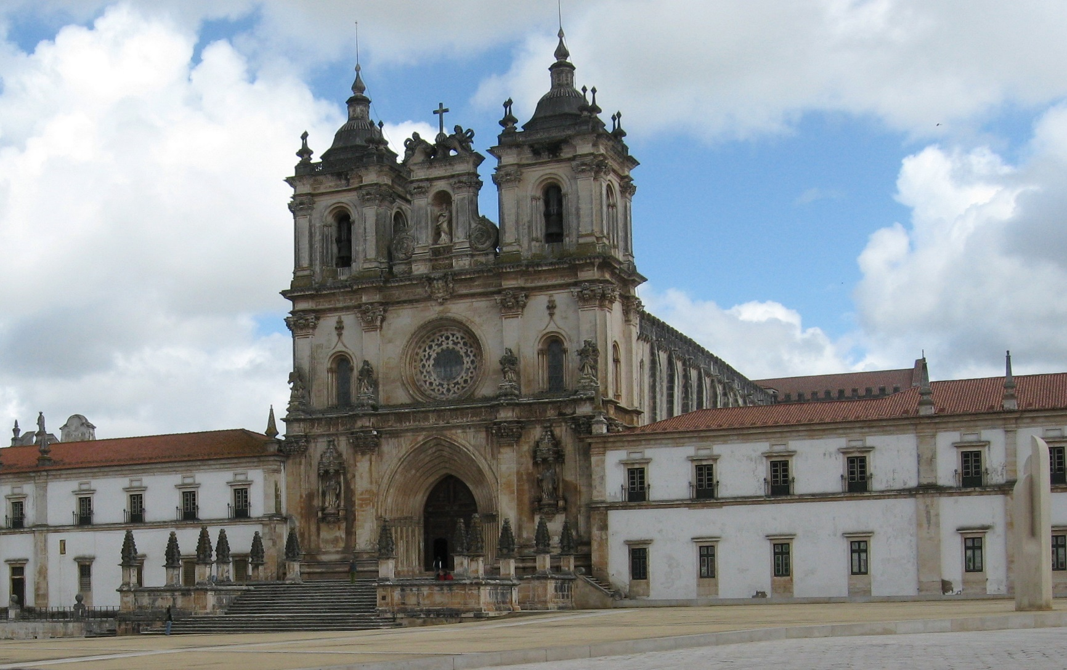
The Monastery of Alcobaça

Slide 16
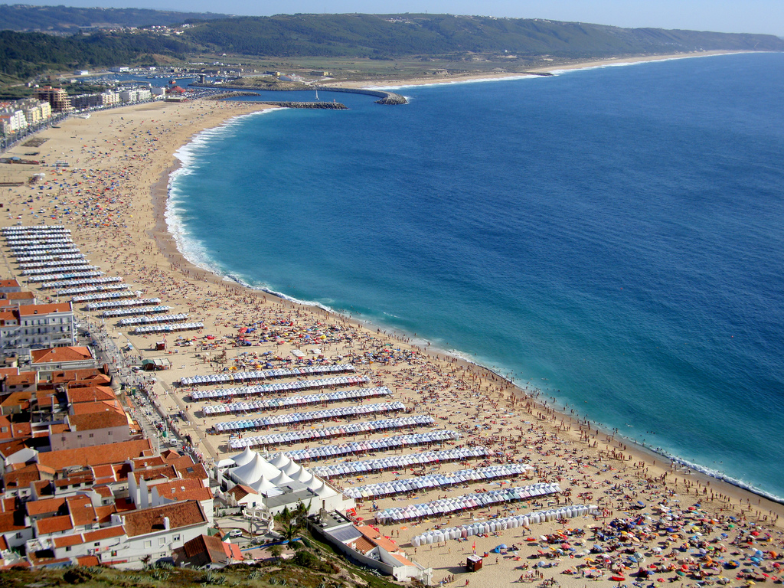
Beaches….

Slide 17
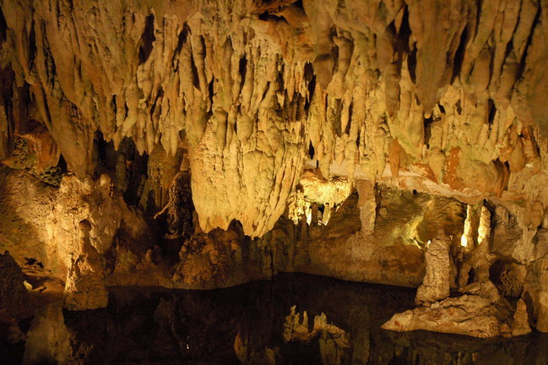
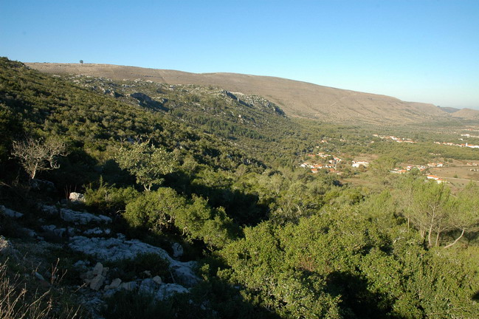
Mountains and caves….

Slide 18
ISLA’s role in the Job-Jo project
Leader of the Quality Plan
(My colleague will be talking about the details of our proposal tomorrow.)

Slide 19
ISLA’s other responsibilities as part of the Job-Jo Project:
Given ISLA’s major experience in business management and human resources training….
The Institute can play an active role in terms of training the BSNB technical staff, teachers and people who the project is aimed at: with a degree or unemployed.

Slide 20
Training BSNB staff
Selecting trainees;
Selecting teachers;
Interview skills;
Pedagogical organisation of the courses;
Organisation of the teacher training courses.
Visit the IEFP (Portuguese body responsible for vocational training) – understand the helplines available to set up a company and to create own job.

Slide 21
Aimed at BSNB teachers
Teacher training courses.

Slide 22
Aimed at graduates and those unemployed
Training in entrepreneurship;
Training in business management.
Training in the behavioural field – behaviour in a work environment: skills expected.
Visiting companies and contacting business people – what type of profile are these organizations looking for?

Slide 23
Aimed at the unemployed
Courses on Employment Techniques – active job search.

Slide 24
Thank You
Hope to see you all very soon in Portugal

